Slide 1
Contents
Introduction
Algorithm
Complexity
Program
Output

Slide 2
Selection Sort
By Badashisha Kharkongor
Ginalford Marwein
Almora Kharkamni
Mebalapynhun Shylla

Slide 3
Introduction
It is a sorting algorithm which uses in place comparison.
It divides the list into two parts: sorted and unsorted.
It finds the smallest element in the unsorted sublist and swaps it with the leftmost unsorted element.

Slide 4
Algorithm
Let ARR is an array having N elements
1. Read ARR
2. Repeat step 3 to 6 for I=0 to N-1
3. Set MIN=ARR[I] and Set LOC=I
4. Repeat step 5 for J=I+1 to N
5. If MIN>ARR[J], then
(a) Set MIN=ARR[J]
(b) Set LOC=J
[End of if]
[End of step 4 loop]
6. Interchange ARR[I] and ARR[LOC] using temporary variable
[End of step 2 outer loop]
7. Exit

Slide 5
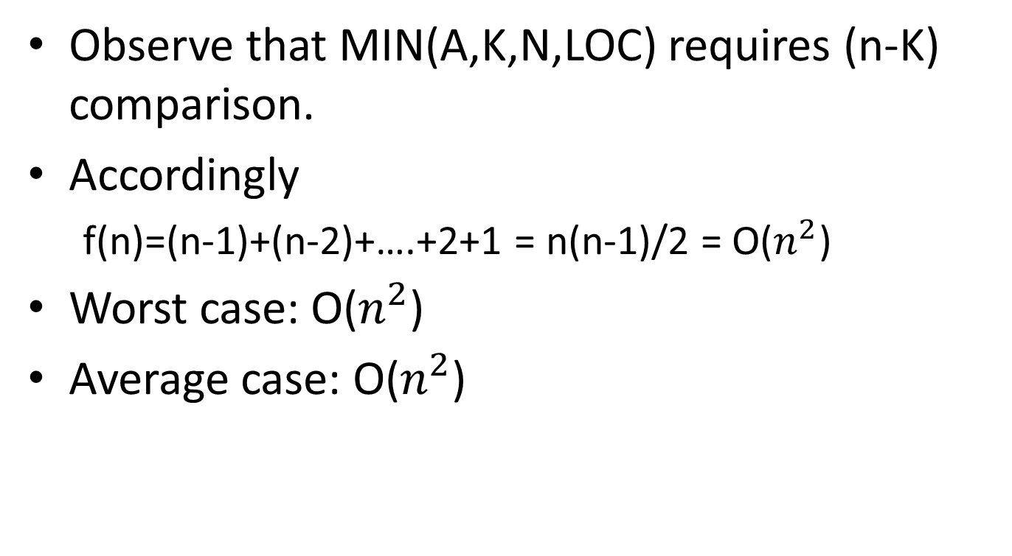
Complexity
Observe that MIN(A,K,N,LOC) requires (n-K) comparison.
Accordingly
f(n)=(n-1)+(n-2)+….+2+1 = n(n-1)/2 = O($n^{2}$)
Worst case: O($n^{2}$)
Average case: O($n^{2}$)

Slide 6
Program
#include<iostream>
#include<conio.h>
void main()
{
int i,j,n,loc,temp,min,a[30];
cout<<"Enter the number of elements:";
cin>>n;
cout<<"\nEnter the elements\n";
for(i=0;i<n;i++)
{
cin>>a[i];
}

Slide 7
Program Cont…
for(i=0;i<n-1;i++)
{
min=a[i];
loc=i;
for(j=i+1;j<n;j++)
{
if(min>a[j])
{
min=a[j];
loc=j;
}
}
temp=a[i];
a[i]=a[loc];
a[loc]=temp;
}

Slide 8
Program Cont…
cout<<"\nSorted list is as follows\n";
for(i=0;i<n;i++)
{
cout<<a[i]<<" ";
}
getch();
}

Slide 9
Output

